Slide 1
Automated Macro-economic Data Analytics Pipeline
End-to-end Data Ingestion, Transformation, And Insight Generation
Name : Majji Prasanth Reddy
Tools & Technologies Used : Python, SQLite, Power BI, REST APIs, Windows Task Scheduler

Slide 2


Problem Statement
The organization lacks a reliable and automated mechanism to ingest, validate, and analyze macro-economic data from multiple public sources, resulting in manual effort, delayed insights, and inconsistent reporting. Without a structured data pipeline and standardized analytics layer, stakeholders have limited visibility into long-term trends, year-over-year growth patterns, and country- or indicator-level performance. This project aims to build an end-to-end automated data pipeline that extracts macro-economic indicators from public APIs, applies robust transformation and data quality checks, stores analytics-ready fact and dimension tables, and delivers an executive-level dashboard to enable timely, consistent, and data-driven economic analysis.

Slide 3
Data Sources
World Bank API
Country-level macro indicators
Multi-year historical coverage
FRED API
Economic time-series indicators
Used to demonstrate multi-source ingestion capability

Slide 4
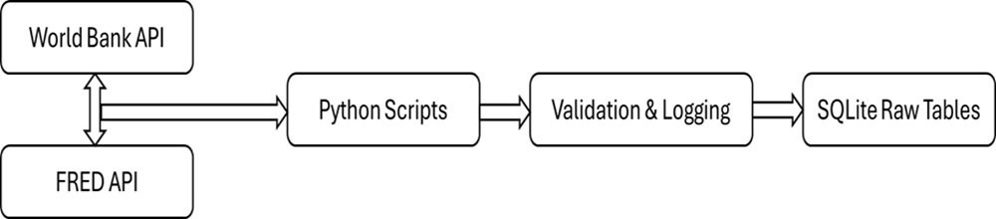
Data Extraction And Ingestion
Automated Python scripts extract macroeconomic data from public APIs
• Annual indicators ingested programmatically from the World Bank API
• Selected economic series ingested from the FRED API for future extensibility
• Ingestion timestamps (ingested_at) added to track data freshness and lineage

Slide 5
Data Storage Layer
Database Used: SQLite
Chosen for simplicity, portability, and analytics-focused workloads.
Tables Created
raw_macro_data (raw ingestion)
fact_macro_annual (analytics-ready fact table)
dim_country
dim_indicator

Slide 6

Data Transformation And Modelling
• Built a structured transformation layer to convert raw API data into analytics-ready tables
• Removed null, empty, and invalid country and indicator codes
• Standardized country and indicator codes using trimming and validation
• Ensured consistent analytical grain: Country × Indicator × Year
Fact Table
• fact_macro_annual
Dimension Tables
• dim_country
• dim_indicator

Slide 7
Data Validation & Quality Checks
Row count validation after transformation
01
Null and blank value checks
02
Duplicate detection and prevention
03
Validation logs generated for auditability
04

Slide 8
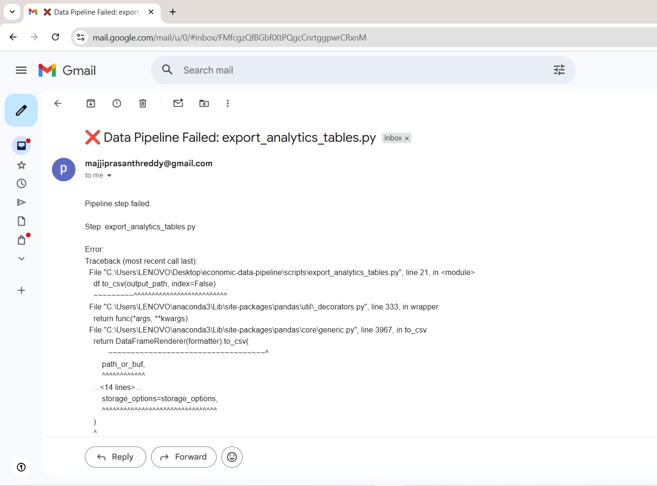
Logging, Monitoring And Email Alerts
Logging Features
Step-level logs (start, success, failure)
Error traceback logging
Timestamped logs for auditability
Alerting
Email alerts triggered on pipeline failure
Enables rapid response and debugging

Slide 9
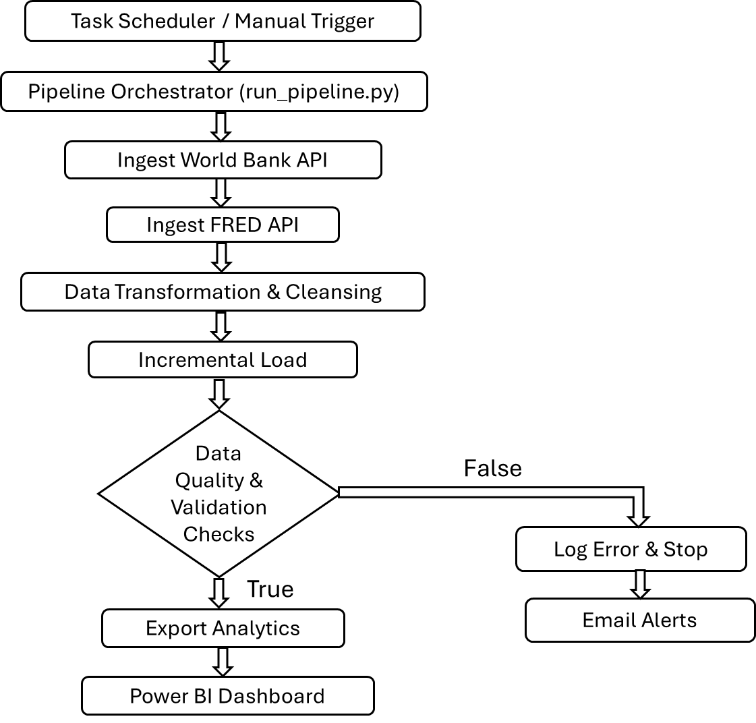
Pipeline Orchestration & Automation
False
True

Slide 10
Task Scheduling & Automation
Automated pipeline execution using Windows Task Scheduler
Scheduled execution of end-to-end data pipeline
Eliminated manual intervention for data refresh
Ensured consistent and timely availability of analytics data

Slide 11

Analytics Interface Layer
Analytics-ready tables were exported as CSV files for BI consumption.
Exports Generated
fact_macro_annual.csv
dim_country.csv
dim_indicator.csv
This decouples engineering from analytics and enables easy BI refresh.

Slide 12
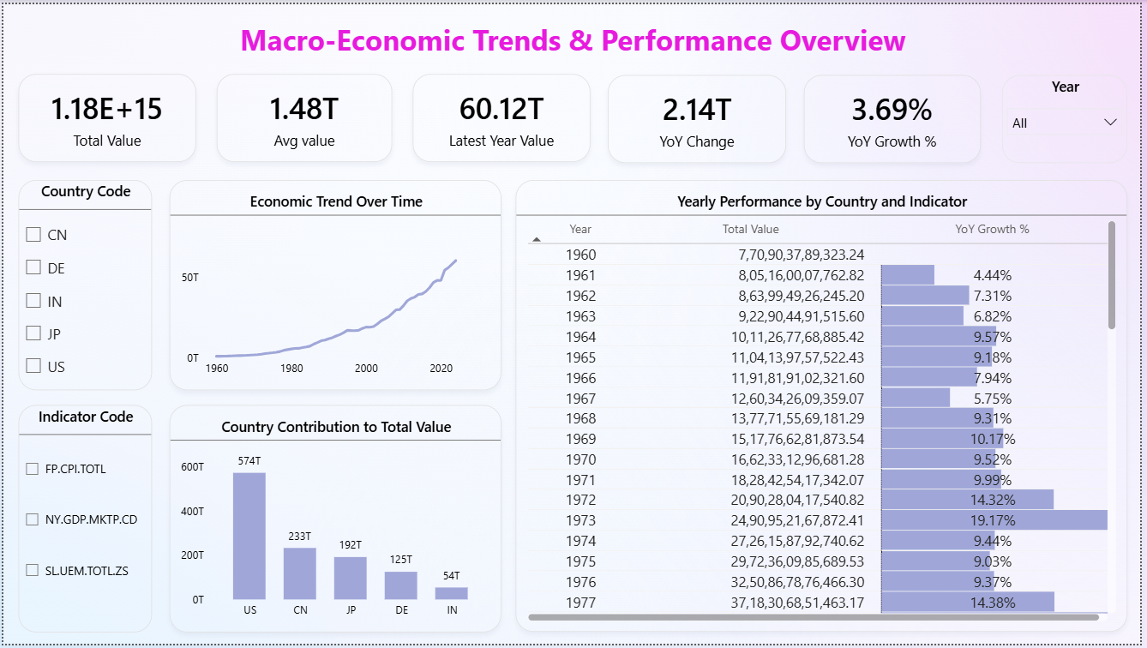
Executive Dashboard Overview

Slide 13
Key Business Insights
Long-Term Aggregate Value Has Grown Consistently Over Time
Recent Period Shows Meaningful Year-over-Year Growth (3.69%)
Latest Year Contribution Is a Significant Share of Historical Total (60.12T)
Country Contribution Is Highly Skewed
Growth Rates Fluctuate Meaningfully Across Years
Automation Enables Multi-Dimensional Filtering Without Reprocessing
“US” consistently contribute higher aggregate values across indicators

Slide 14
Business Recommendations
Focus on Growth Indicators
Prioritize indicators that consistently show positive year-over-year growth to identify long-term performance drivers.
1
Use Rolling Averages for Stability
Rely on rolling average metrics to smooth short-term volatility and support more stable decision-making.
2
Segment Analysis by Indicator
Support aggregate trends with indicator-level analysis to uncover granular drivers behind overall performance.
3
Enable Automated Refresh
Schedule automated pipeline executions to ensure dashboards always reflect the most recent available data.
4
Extend with Predictive Models
Enhance the solution by adding forecasting and scenario analysis for forward-looking decision support.
5

Slide 15


